Slide 1
Assignment
09-04-2025
Presented by S. Vinish

Slide 2
Overview of Key SAP Solutions
SAP Ariba, SuccessFactors, Concur, BTP, S/4HANA, and SCP Integrations

Slide 3
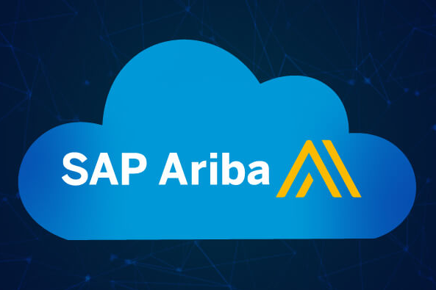
What is SAP Ariba?
Ariba is a Cloud-based procurement and supply chain platform.
Manages sourcing, procurement, contracts, and supplier performance.
SAP Ariba Integrations:
SAP S/4HANA: Enables seamless procurement processes and real-time insights.
SAP Business Network: Helps in connecting suppliers and buyers.
Third-party Applications: Can integrate with non-SAP systems using APIs, middleware (like SAP Cloud Platform Integration), and standard protocols (e.g., EDI, Web Services).

Slide 4
What is SAP SuccessFactors?
Cloud-based HRMS for talent management and employee experience.
Includes recruitment, learning, compensation, and performance.
SAP SuccessFactors vs SAP HR:
Deployment: SuccessFactors is cloud-based, while SAP HCM is typically on-premise.
Scope: SuccessFactors emphasizes talent management and employee experience. SAP HCM is more focused on core HR, time, and payroll processing.
User Experience: SuccessFactors has a more modern and intuitive interface.
Updates: SuccessFactors receives regular updates from SAP, while SAP HCM updates are more manual.

Slide 5
Other Purposes of SAP Concur
SAP Concur is an expense and travel management solution.
It is a cloud-based management solution.
Besides managing travel expenses, it helps businesses:
Automate expense reporting and approval workflows.
Track travel bookings and receipts.
Streamline compliance and policy enforcement.
Enhance visibility and control over company spending.

Slide 6
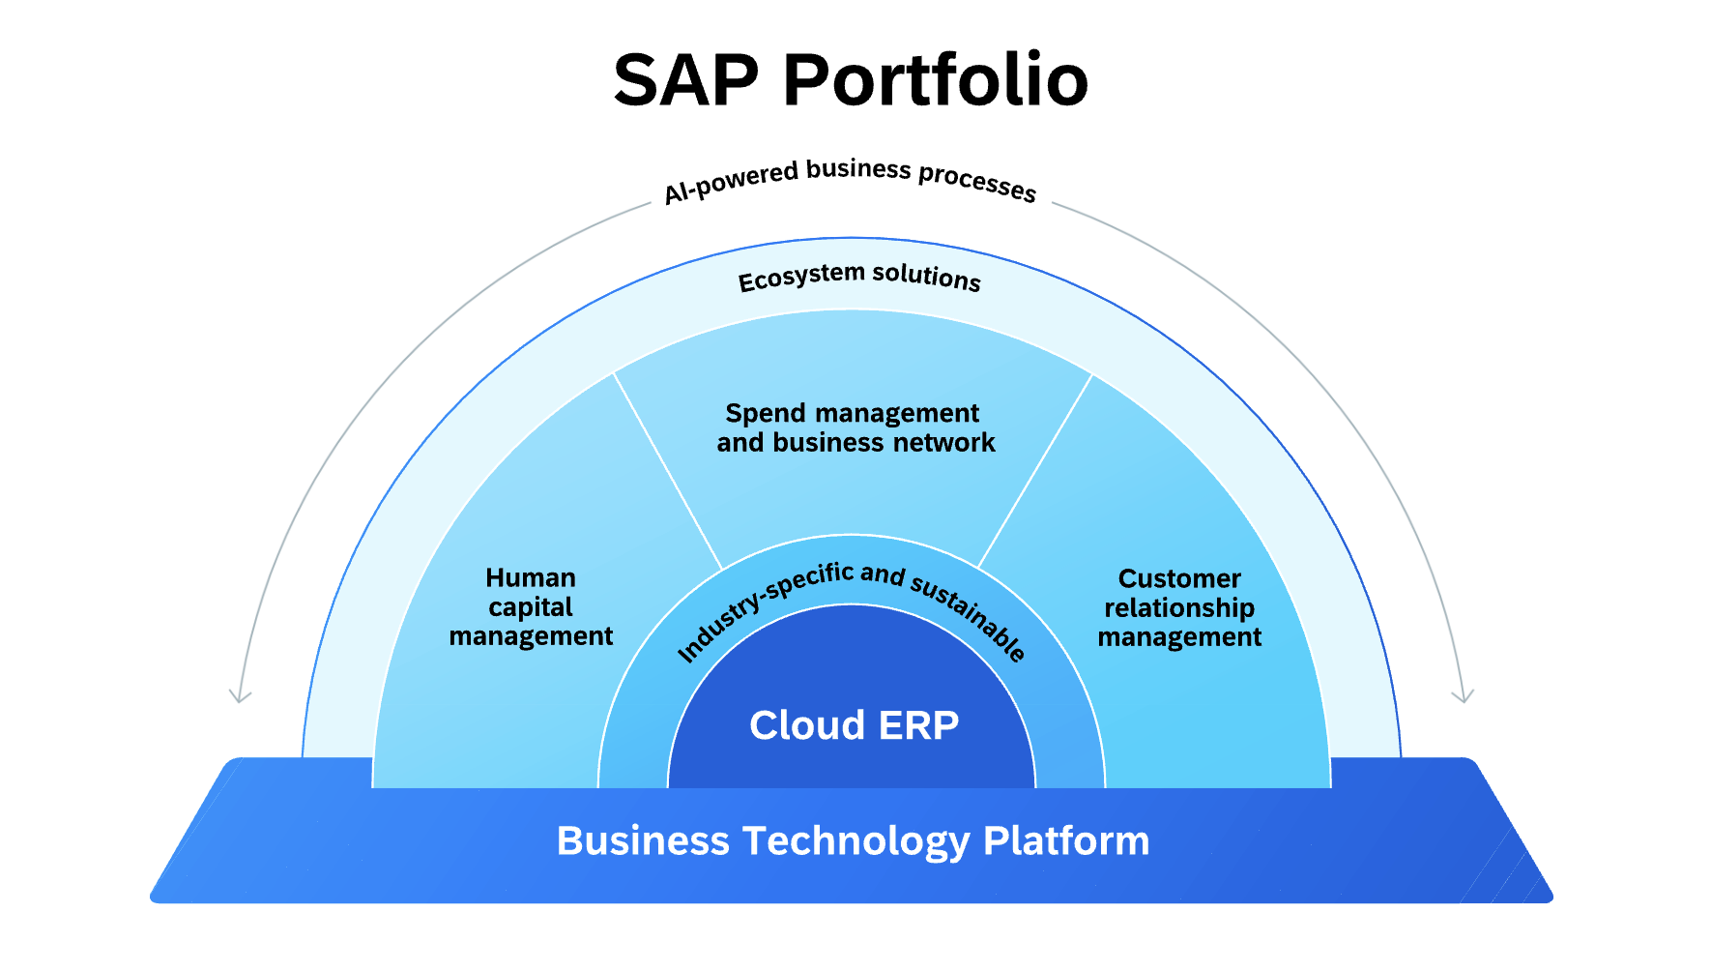
What is SAP BTP?
Business Technology Platform for managing data, integration, and process management in cloud.
Supports app development, analytics, and extension of SAP solutions.

Slide 7
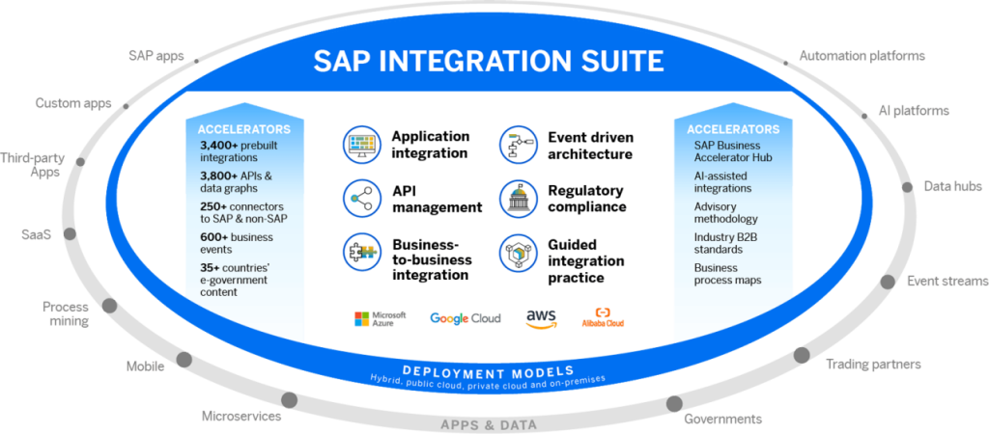
SAP BTP Integrations
Integrates with SAP apps like S/4HANA, Ariba, and SuccessFactors.
Supports third-party app integration via APIs and SAP Integration Suite.

Slide 8
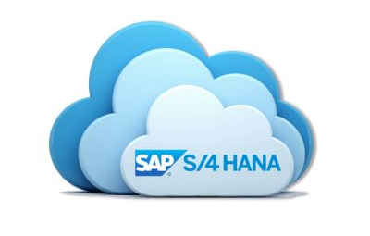
SAP S/4HANA Versions
SAP S/4HANA comes in two main versions:
On-premise: Deployed locally within the company's infrastructure.
Cloud: Delivered as a cloud solution with faster updates, lower upfront costs, and scalability.
Differences:
Customization: On-premise offers more customization options.
Maintenance: Cloud version has lower maintenance overhead as SAP handles updates and infrastructure.
Deployment Speed: Cloud is quicker to deploy.

Slide 9
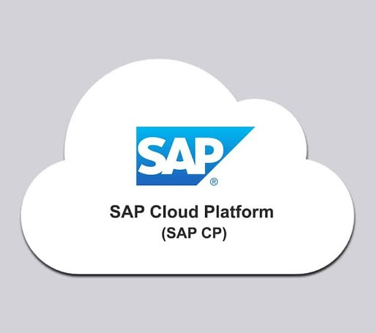
SAP Cloud Platform (SCP) Integrations
SAP Cloud Platform is a platform-as-a-service (PaaS) offering that allows businesses to build, extend, and integrate SAP applications.
Integrations to SCP:
SAP Applications: Integrates with other SAP products like SAP S/4HANA, SAP SuccessFactors, SAP Ariba, etc.
Third-party applications: Integrates with third-party systems such as Salesforce, Microsoft, and others using REST APIs, SOAP, or custom adapters.

Slide 10
Thank You

